Slide 1
UNIBZ
ROOMFINDER
Seminars in Software & IT Engineering
Danilo Fink Luca Pellegrini Faheem Shahid
Nuzula Muscha
Anjan Karmakar
Gabriele Minneci
Srishti Gaihre
Heider Jeffer

Slide 2
Roadmap
Problem to be solved
Software Requirements
Development process
Software architecture
Software design
Software tools
Demo

Slide 3
Problem to be solved
Students need to know places where they can study when the library is full
The most critical period is the exam session
Our application helps the students to know where are the available rooms in a specific time
Notes:
1)The problem we are going to discuss here is to find free rooms in the university. Where students can study freely and make group discussion without any hesitation and restriction.
2)During exams days every student wants to get place in library, but they refused and, they don’t know about the available free rooms in university to study. And they try to find free rooms door to door.
3)Our application provides a platform where students can find free rooms in university. Students can find free rooms by selecting their specific times and by room number/name. using our application students can save their precious time especially during exams

Slide 4
Software Requirements
Main goal
Show available rooms at a given point in time
Additional:
Show the period of time a room is free and where the room is
Show rooms that are available during a specified time range
Show availability of a specific room on a specific day
Filter rooms by building
The application should run on multiple platforms (mobile and desktop)
Notes:
nuzula

Slide 5
Development process
Agile
Group sessions
Pair programming
Scrum → Weekly meetings (Agile Iterations)
Notes:
luca

Slide 6
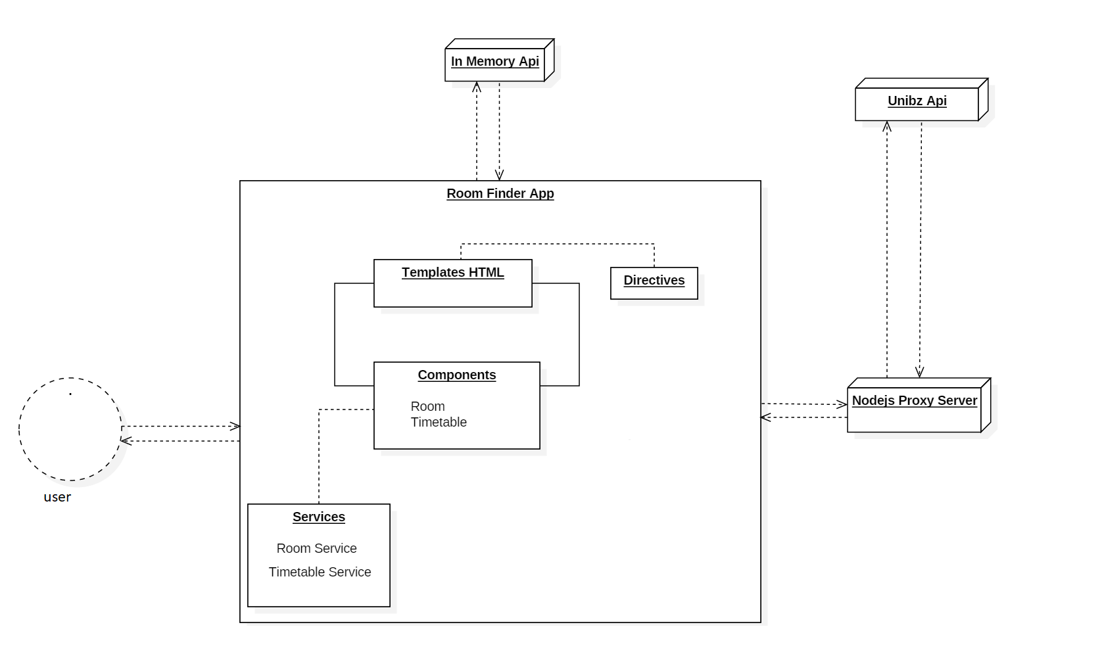
Software Architecture
Notes:
danilo

Slide 7
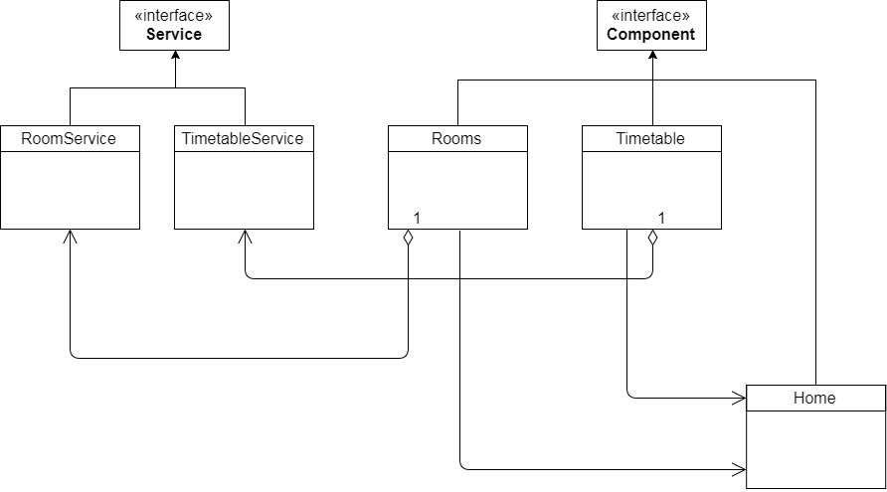
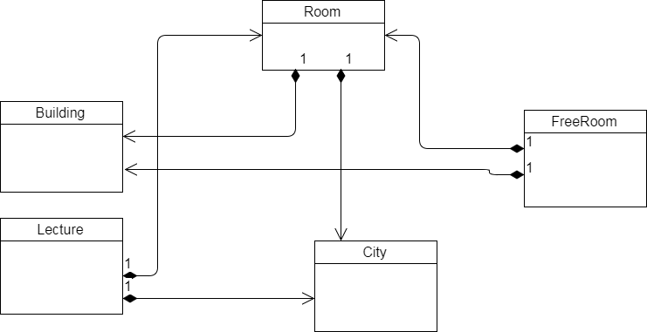
Software Design
Notes:
anjan

Slide 8


Software Tools
Notes:
gabriele:
focus on development tools
drive&trello: cooperation and management
script AWS for deployment
Karma + Jasmine-> Unit testing & service-component testing + Luca problems encountered

Slide 9
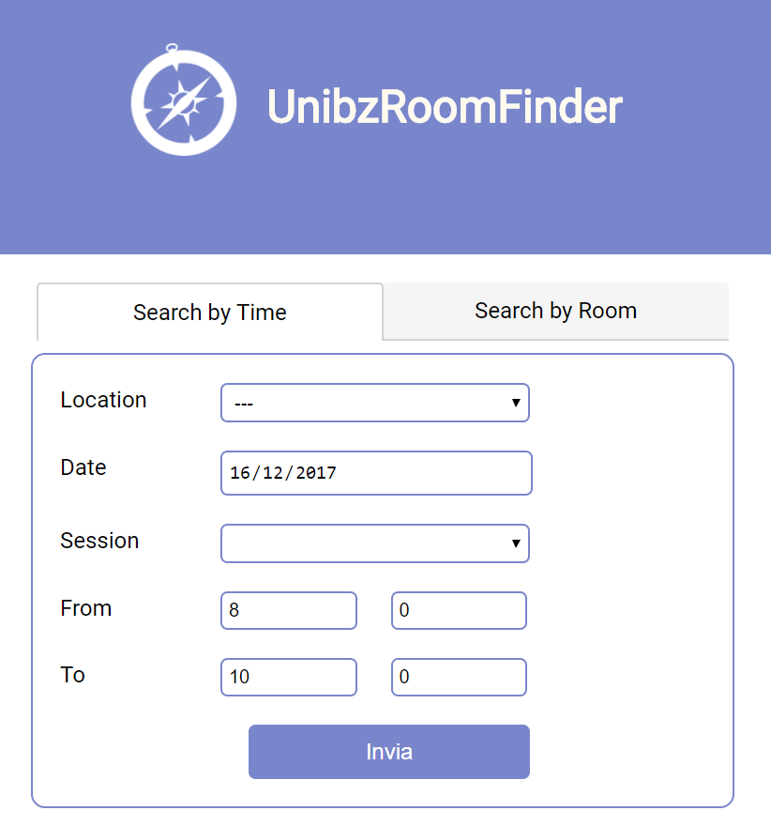
Now we show a short DEMO
Notes:
srishti

